Slide 1



Celiac Symptom Tracker
By
Oisín Wilson

Slide 2

Agenda
Abstract
Purpose of the Research
Project & Featureset
Overview Architecture
Technology
Testing and Results
Video
Q&A

Slide 3
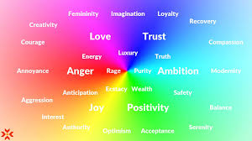
Abstract
A study in colour psychology with technology and how it can influence perceptions, enhance the effectiveness of applications and change people's behavior

Slide 4
Purpose of the Research
The purpose of this project is to provide an application which persuades Celiac Patients to perform a particular action, in this case journaling their dietary habits.
This will allow them to better understand how diet intake effects their long term wellbeing.
By providing real data feedback, it is the goal of the project to change a Celiac Patient’s behaviour for real health benefits.

Slide 5
Project & Features
Provide an easy to use Smart Phone Application that helps Celiac Patients to journal their dietary habits, track their daly health and provide visual feedback on how their symptoms are affecting their overall wellbeing. The goal is to change a parent's behaviour through visual feedback.
The Features of the Project are:
Basic react Native
Component Camera Barcode
Rest API calls to Open Product API
Out of App Push Notifications
Screen Switching
Calendar
Charts & Graphs
Local Database Integration
Scanner Optical Character Recognition

Slide 6
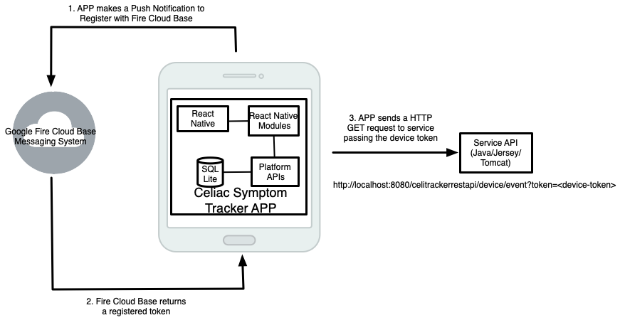
Architecture - App Registration

Slide 7
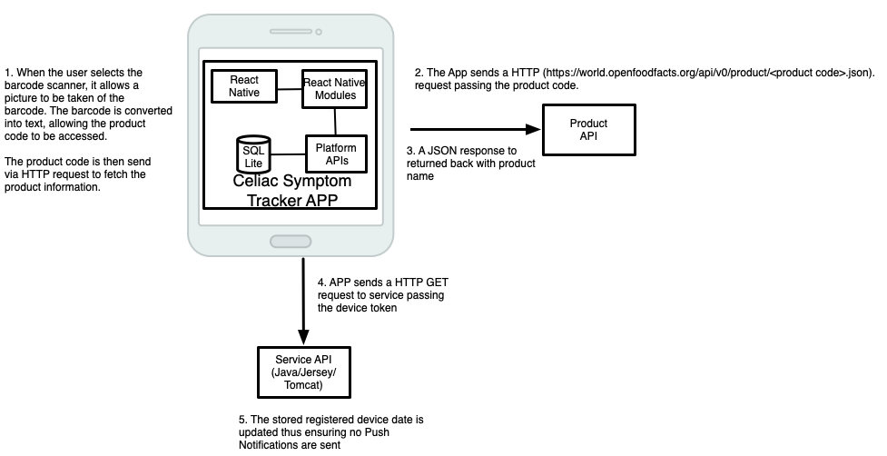
Architecture - App Barcode Scanning / Data Input

Slide 8
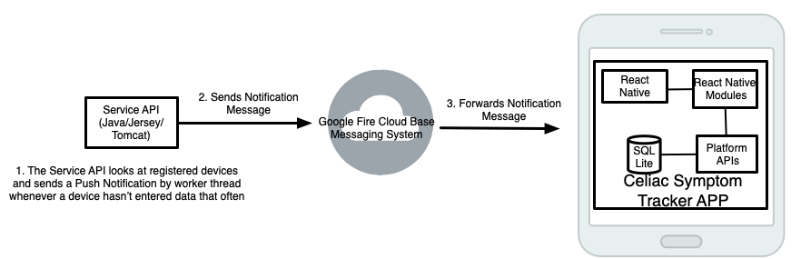
Architecture - App Push Notifications

Slide 9
Technologies - Application
React
React is a JavaScript library for building user interfaces. It is maintained by Facebook and a community of individual developers and companies. React can be used as a base in the development of single-page or mobile applications.
React Native
React Native combines the best parts of native development with React, a best-in-class JavaScript library for building user interfaces. Allowing the same native code to be used across Android and IOS.
JavaScript
JavaScript is a dynamic programming language. Used as a part of web pages, whose implementations allow client-side scripts to interact with the user and dynamic pages.

Slide 10
Technologies - Application (pt2)
Expo
Expo is a framework and a platform for universal React applications. It is a set of tools and services built around React Native and native platforms that help you develop, build, deploy and quickly integrate on IOS, Android and web apps from the same Javascript/TypeScript codebase.
Android Studio
Android Studio is the official integrated development environment for Google’s Android operating system and designed specifically for Android development. It is available for download on Windows, MacOs and Linux based operating systems.
Local Database Integration
SQLite is an open source SQL database that stores data to a text file on a device. Android comes in with built in SQLite database implementation.

Slide 11

Technologies - Cloud Messaging Services
Firebase cloud Messaging Platform is a free mobile notification service by Google that enables app developers to send notifications from their Server to the users mobile device.

Slide 12
Technologies - Service API
Java Programming Language
Java is a general-purpose, concurrent, object-oriented, class-based, compile once, run anywhere platform Programming Language.
Tomcat Server
Apache Tomcat is an open-source implementation of the Java Servlet and WebSocket technologies. Tomcat provides a “pure Java” HTTP web server environment in which Java code can run.
Apache HTTP Client
Apache HTTP client is an open source Java based library which provides HTTP GET/POST functionality, Authentication, State management and HTTP connection management.

Slide 13
Technologies - Service API (pt2)
Jersey Rest Web Framework
Jersey is an open source REST Web Service framework used in the production of developing a REST API in Java.
JSON
JavaScript Object Notation, is a minimal, readable format for structuring data. It is used primarily to transmit data between a server and web application.
Eclipse
Eclipse is an integrated Development Environment (IDE) used in computer programming. The Eclipse (SDK) includes the Java development tools to be used by Java developers.
Mavin (plugin for Eclipse)
Marvin is a powerful utility that uses a POM (project object model) file to build projects and get their dependencies.

Slide 14
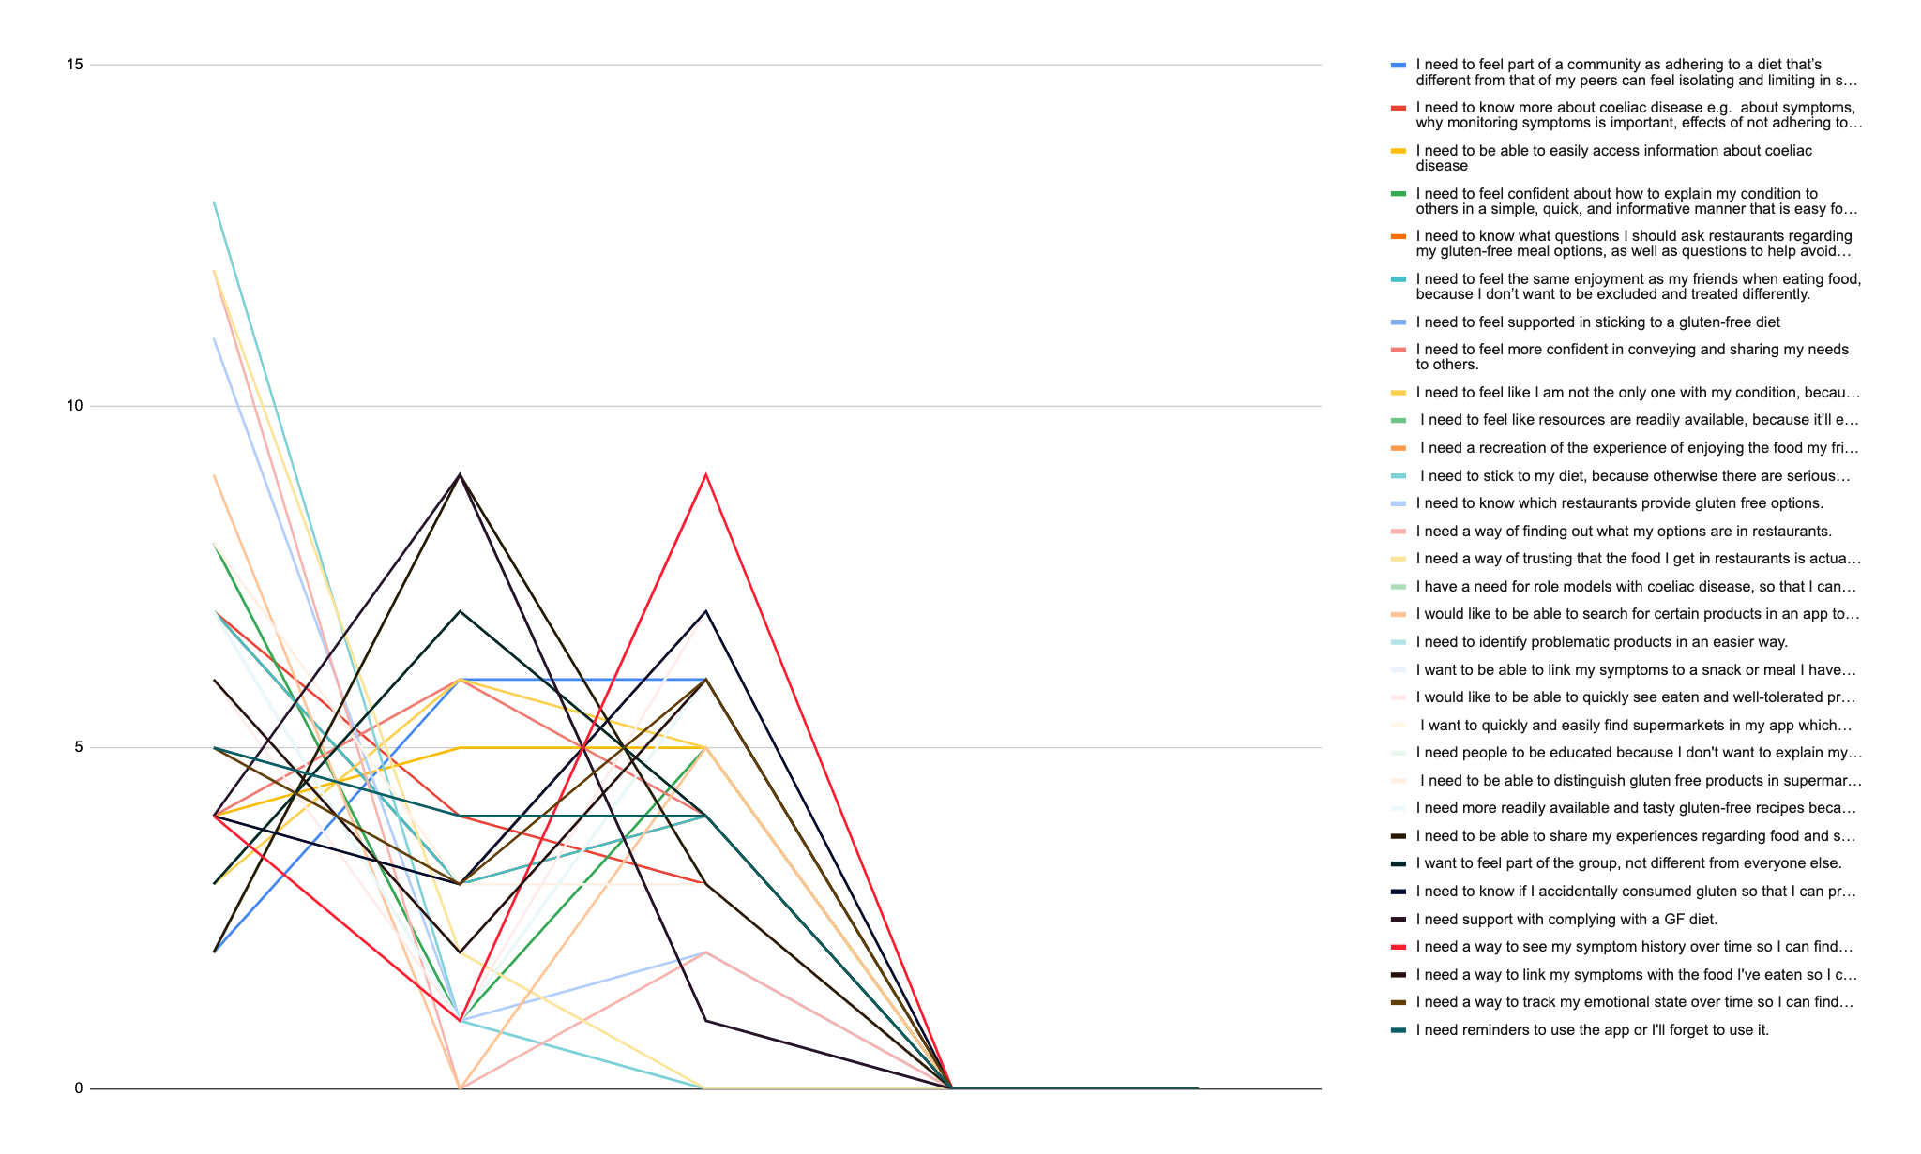
Testing and Results
Due to the current pandemic only the first wave of two 21 day challenges was completed, leaving the dataset incomplete.
However with this limited data the consensus is that showing a visual connection between diet and symptoms isn’t a want, but a need from the user.
This means using display designs that heavily utilize colour psychology will create a UX that manifests and underlying association of colour to action, thus reinforcing the desired dietary behaviour

Slide 15
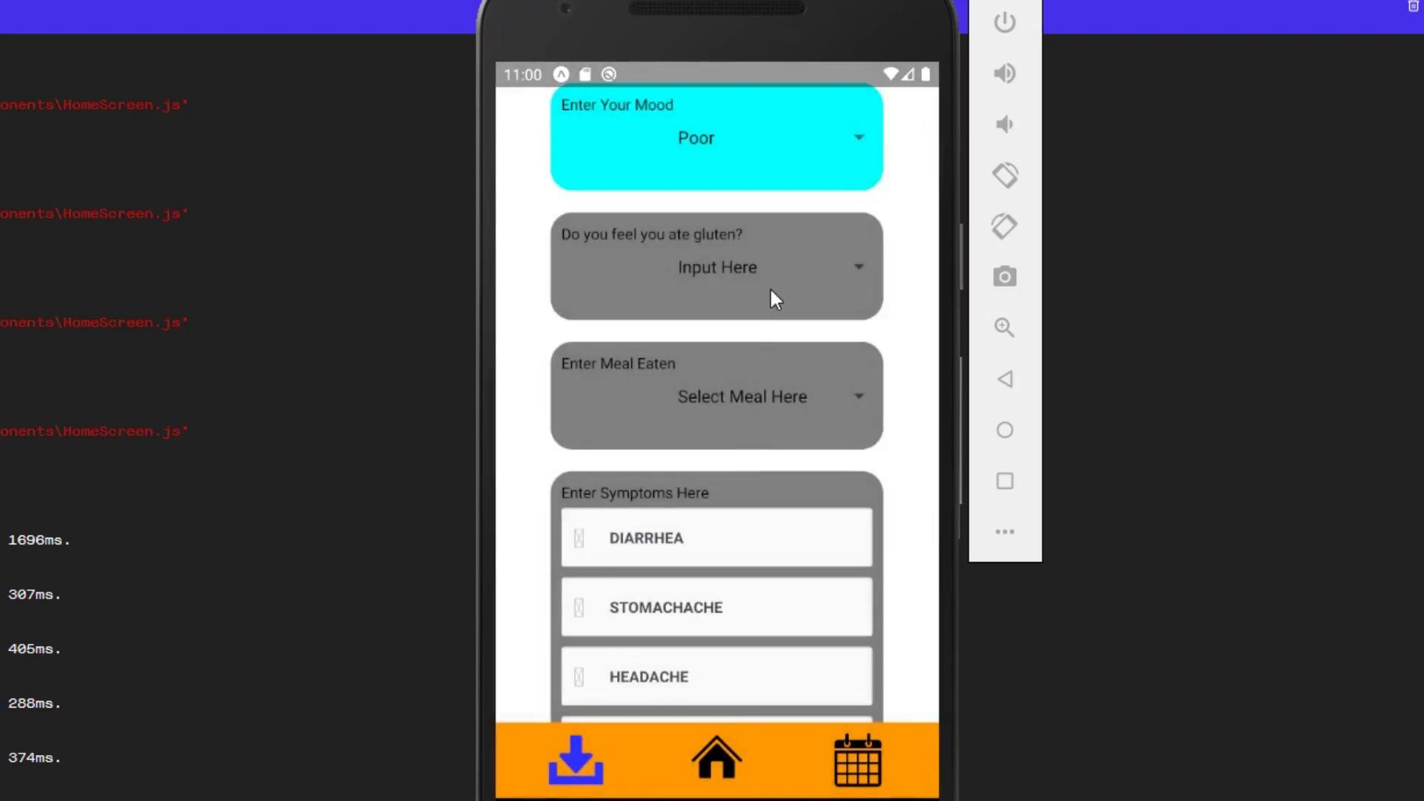
Video

Slide 16
Questions & Answers
Thank You For Your Time!

